Slide 1


8086 Interrupts
Source:
‘Microprocessors and Interfacing’, by Douglas V Hall
Presented by
Mahbubur Rahman
Lecturer
Department of Computer Science and Engineering(CSE)
Green University of Bangladesh(GUB)

Slide 2
Contents
Introduction
Interrupts
Types of Interrupts
Hardware Interrupts
Maskable and Non-maskable Interrupts
Software Interrupts
256 Interrupts
Conclusion

Slide 3
Introduction
The meaning of “interrupts” is to break the sequence of operation.
While the microprocessor is executing a program, an “interrupt” breaks the normal sequence of execution of instructions, diverts its execution to some other program called Interrupt Service Routine (ISR).
After executing, control returns the back again to the main program.

Slide 4
Interrupt
Keeping moving until interrupted by the sensor.
Interrupt received then do pre-defined operation.
After finishing the interrupt service return to normal operation i.e. keep moving forward again.

Slide 5
The processor can be interrupted in the following ways –
By an external signal generated by the peripheral.
By an external signal generated by a special instruction in the program.
By an internal signal generated due to an exceptional condition which occurs while executing an instruction.

Slide 6
Interrupt
Normal program execution is interrupted by
Some external signal, or
A special instruction in the program
In response to an interrupt,
the microprocessor stops executing its normal program &
calls a procedure which ‘services’ the interrupt.
An IRET instruction at the end of the interrupt-service procedure returns execution to the interrupted program.

Slide 7
8086 interrupt can come from 3 sources:
Hardware interrupt: An external signal – applied
To the nonmaskable interrupt (NMI) input pin, or
To the interrupt (INTR) input pin
Software interrupt: Execution of the Interrupt instruction, INT
Error condition: If some error condition occur by the execution of an instruction. e.g.,
Divide-by-zero interrupt: If we attempt to divide an operand by zero, the 8086 will automatically interrupt the currently executing program

Slide 8
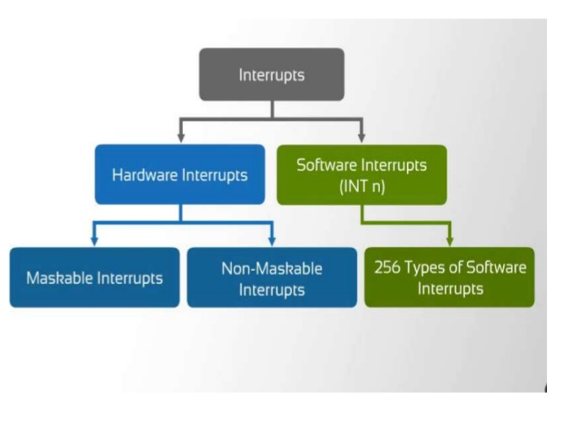

Slide 9
Hardware Interrupts
The interrupts initiated by external hardware by sending an appropriate signal to the interrupt pin of the processor is called hardware interrupt. The 8086 microprocessor has two interrupt pins INTR and NMI. The interrupt initiated by applying appropriate signal to these pins are called hardware interrupts of 8086.

Slide 10
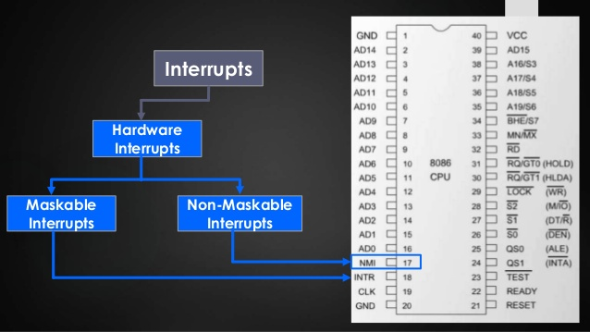

Slide 11
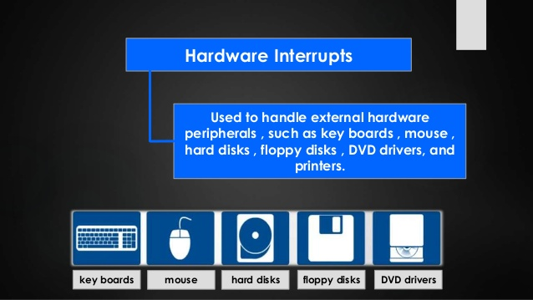

Slide 12
Maskable and Non-Maskable Interrupts
The processor has the facility for accepting or rejecting hardware interrupts. Programming the processor to reject an interrupt is referred to as masking or disabling and programming the processor to accept an interrupt is referred to as unmasking or enabling. In 8086 the interrupt flag (IF) can be set to 1 to unmask or enable all hardware interrupts except NMI. The interrupt whose request can be either accepted or rejected by the processor are called maskable interrupts.

Slide 13
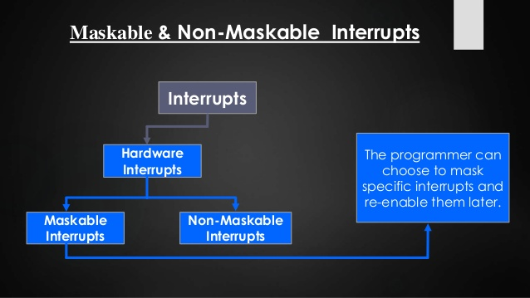

Slide 14
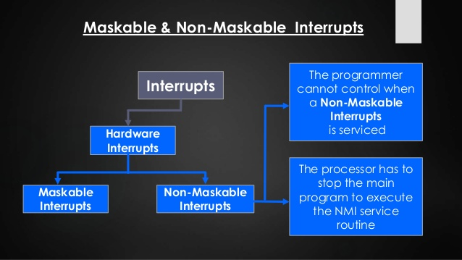

Slide 15
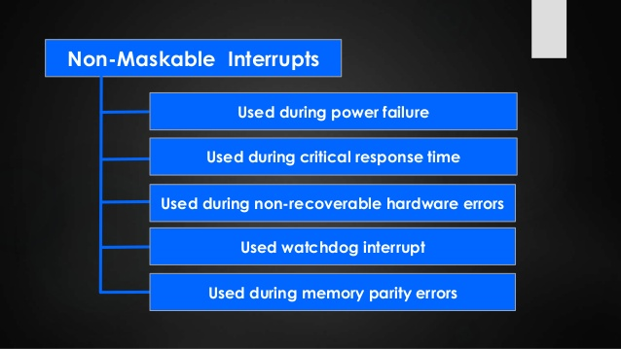

Slide 16
Software Interrupts
The software interrupts are program instructions. These instructions are inserted at desired locations in a program. While running a program, if software interrupt instruction is encountered then the processor initiates an interrupt. The 8086 processor has 256 types of software interrupts. The software interrupt instruction is INT n, where n is the type number in the range 0 to 255.

Slide 17
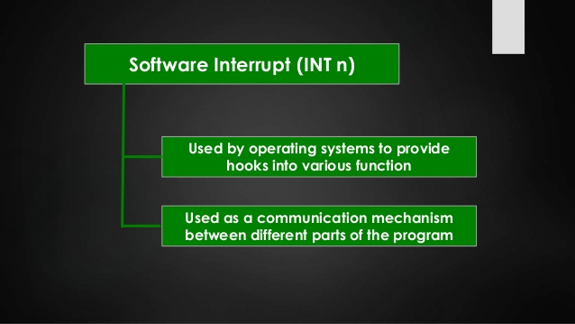

Slide 18
8086 interrupt types
256 interrupts of 8086 are divided into 3 groups
Type 0 to Type 4 interrupts
These are used for fixed operations and hence are called dedicated interrupts.
Type 5 to Type 31 interrupts
Not used by 8086, reserved for higher processor like 80286, 80386 etc.
Type 32 to Type 255 interrupts
Available for user, called user defined interrupts. These can be hardware interrupts and activated through INTR line or can be software interrupts.

Slide 19
Type – 0 Divide Error Interrupt
Quotient is large. Can’t be fit in AX or divide by 0.
Type – 1 Single Step Interrupt
Used for executing the program in single step mode by setting Trap flag
Type – 2 Non-Maskable Interrupt
This interrupt is used for execution of NMI pin.
Type – 3 Break Point Interrupt
Used for providing break points in the program.
Type – 4 Overflow Interrupt
Used to handle any overflow error.

Slide 20
Interrupt Vectors
The Interrupt Vector contains the address of the interrupt service routine.
The Interrupt Vector Table is located in the first 1024 bytes of memory at address 00000H-003FFH.
It contains 256 different 4-byte interrupt vectors, grouped in 18 types
000H: Type 0 (Divide error)
004H: Type 1 (Single-step)
008H: Type 2 (NMI)
00CH: Type 3 (1-byte breakpoint)
010H: Type 4 (Overflow)

Slide 21
Interrupt Vectors
014H: Type 5 (BOUND)
018H: Type 6 (Undefined opcode)
01CH: Type 7 (Coprocessor not available)
020H: Type 8 (Double fault)
024H: Type 9 (Coprocessor segment overrun)
028H: Type 10 (Invalid task state segment)
02CH: Type 11 (Segment not present)

Slide 22
Interrupt Vectors
030H: Type 12 (Stack segment overrun)
034H: Type 13 (General protection)
038H: Type 14 (Page fault)
03CH: Type 15 (Unassigned)
040H: Type 16 (Coprocessor error)
044H-07CH: Type 17-31 (Reserved)
080H: Type 32-255 (User)

Slide 23
Interrupt Types –
Type 0: Divide error – Division overflow or division by zero
Type 1: Single step or Trap – After the execution of each instruction when trap flag set
Type 2: NMI Hardware Interrupt – ‘1’ in the NMI pin
Type 3: One-byte Interrupt – INT3 instruction (used for breakpoints)
Type 4: Overflow – INTO instruction with an overflow flag
Type 5: BOUND – Register contents out-of-bounds
Type 6: Invalid Opcode – Undefined opcode occurred in program
Type 7: Coprocessor not available – MSW indicates a coprocessor
Type 8: Double Fault – Two separate interrupts occur during the same instruction
Type 9: Coprocessor Segment Overrun – Coprocessor call operand exceeds FFFFH

Slide 24
Interrupt Types –
Type 10: Invalid Task State Segment – TSS invalid (probably not initialized)
Type 11: Segment not present – Descriptor P bit indicates segment not present or invalid
Type 12: Stack Segment Overrun – Stack segment not present or exceeded
Type 13: General Protection – Protection violation in 286 (general protection fault)
Type 14: Page Fault – 80386 and above
Type 16: Coprocessor Error – ERROR΄ = ‘0’ (80386 and above)
Type 17: Alignment Check – Word/Doubleword data addressed at odd location (486 and above)
Type 18: Machine Check – Memory Management interrupt (Pentium and above)

Slide 25
At the end of each instruction cycle, 8086 checks to see if any interrupts have been requested.
If an interrupt has been requested – the 8086 responds to the interrupt by stepping through the following series of major actions:

Slide 26
It decrements the stack pointer by 2 and pushes the flag register on the stack.
It disables the INTR interrupt input – by clearing the interrupt flag (IF) in the flag register.
It resets the trap flag (TF) in the flag register.
It decrements the stack pointer by 2 and pushes the current code segment register contents on the stack.

Slide 27
5. It decrements the stack pointer again by 2 and pushes the current instruction pointer contents on the stack.
6. CS and IP are loaded with new addresses derived from the interrupt type number.
7. 8086 microprocessor executes the ISR to service the interrupt.

Slide 28
Divide-by-zero interrupt – Type 0
8086 will automatically do a type – 0 interrupt if
The result of a DIV operation or
An IDIV operation
is too large to fit in the destination register
→ Too large!? Infinity!

Slide 29
Write program in a way so that can manage –
E.g., make sure that the divisor is not zero
[to avoid infinity result]; and
Do the division in several steps so that result of the division will never be too large.
Another way –
Write an interrupt-service procedure which takes the desired action when an invalid division occurs.

Slide 30
Nonmaskable interrupt – type 2
8086 will automatically do a type 2 interrupt response when – it received a low-to-high [0 to 1] transition on its NMI input pin.

Slide 31
This interrupt can not be disabled/masked – by any program instructions.
As this input can’t be intentionally or accidentally disabled, external system must be taken care of.

Slide 32
Example 1 –
We could have a pressure sensor on a large steam boiler – connected to the NMI input.
If the pressure goes above a preset limit, the sensor will send an interrupt signal to the 8086.
Type 2 interrupt-service procedure for this case might
turn off the fuel to the boiler
open a pressure-relief valve and
sound an alarm!

Slide 33
Example 2 –
To save program data in case of a system power failure.
When AC power fails – some external circuitry detects it.
Sends an interrupt signal to the NMI input pin.
Because of the large filter capacitors in most power supplied, the dc system power will remain for perhaps 50ms – after the AC power is gone.

Slide 34
This is enough time for a type 2 interrupt-service procedure to copy program data to some RAM, which has a battery backup power supply.
When the AC power returns, program data can be restored from the battery-backed RAM,
and the program can resume execution where it left off.

Slide 35
Conclusion
The CPU executes program, as soon as a key is pressed, the keyboard generates an interrupt. The CPU will response to the interrupt – read the data. After that returns to the original program. So by proper use of interrupt, the CPU can serve many devices at the same time.

